Slide 1



FITNESS TRACKER SYSYTEM -AN OVERVIEW OF MACHINE LEARNING AND STREAMLIT INTEGRATION
PRESENTED BY: HARITHA P V
INTERN ID: MST03-0058
GUIDED BY: UROOJ KHAN

Slide 2
CONTENT
INTRODUCTION
DATASET
DATA CLEANING AND FEATURE ENGINEERING
DATA VISUALIZATION
MACHINE LEARNING MODELS
RESULT
STREAMLIT APP DEVELOPMENT
SUMMARY
FUTURE SCOPE

Slide 3
INTRODUCTION
Develop a comprehensive fitness tracking system to monitor physical activity and health metrics.
Utilizes Polynomial Regression and Random Forest to predict physical activity levels.
Provides an interactive user interface for real-time data visualization and predictions.
Includes BMI calculator, goal tracking, model prediction and dataset insights for personalized fitness management.

Slide 4
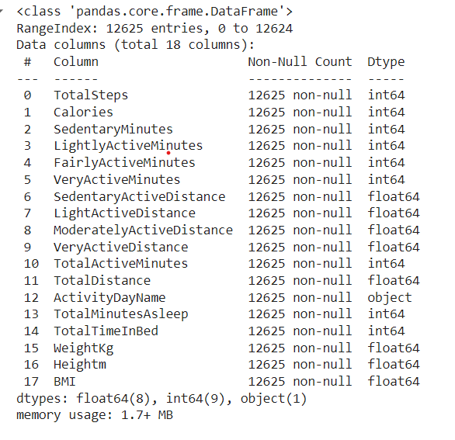
DATASET
The dataset initially consisted of 12,625 entries capturing various aspects of individuals' physical activities and health metrics.
18 Features covering aspects like weight, height, activity levels, sleep patterns, and calories burned.
The dataset primarily includes numerical data, providing a detailed view of physical health metrics suitable for predictive modeling and analysis.
Fig: Dataset info

Slide 5
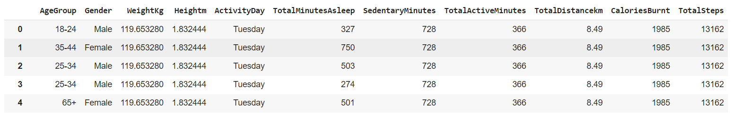
DATA CLEANING AND FEATURE ENGINEERING
122 duplicate entries were identified and removed, resulting in 12,503 records.
Created categorical features for demographic analysis.
Removed unnecessary columns that didn't contribute to the analysis or model performance.
After all preprocessing steps, the dataset now contains 12,503 rows and 11 columns, optimized for model training and evaluation.

Slide 6
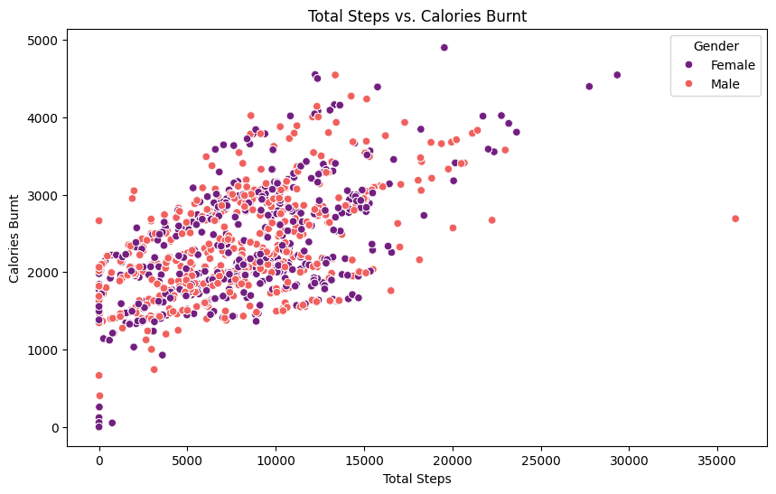
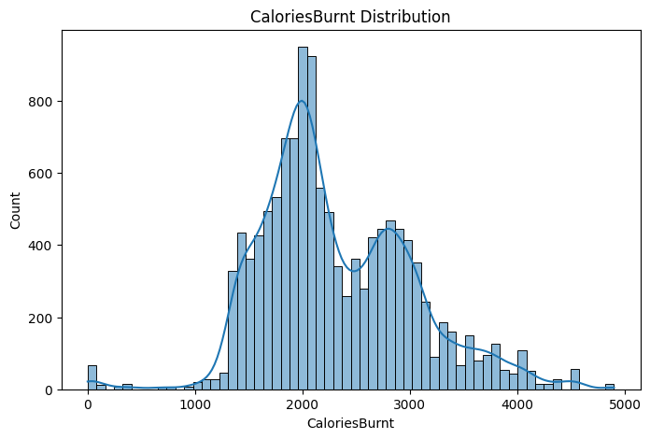
DATA VISUALIZATION
Fig: Total steps vs calories burnt
Fig: Calories burnt distribution

Slide 7

MACHINE LEARNING MODELS
Polynomial Regression Handles non-linear relationships between features and target variables effectively.
Allows for higher-degree polynomials to fit complex patterns in the data.
Random Forest Combines multiple decision trees to improve accuracy and reduce overfitting.
Provides insights into the importance of different features in making predictions.
Polynomial Regression and Random Forest provide a balanced approach, offering flexibility, interpretability, and robustness.

Slide 8
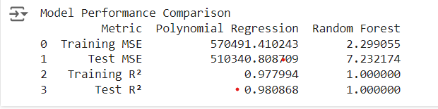
RESULT
Random Forest has a significantly lower training MSE, indicating a better fit to the training data.
Random Forest shows much lower test MSE, demonstrating superior performance on unseen data and better generalization.
Random Forest achieves a perfect R² score on training data(1.000), while Polynomial Regression is slightly lower (0.978), indicating better model fit.
Random Forest maintains a perfect R² score on test data(1.000), showcasing excellent model performance and accuracy compared to Polynomial Regression(0.981).
Fig: Comparison of models

Slide 9
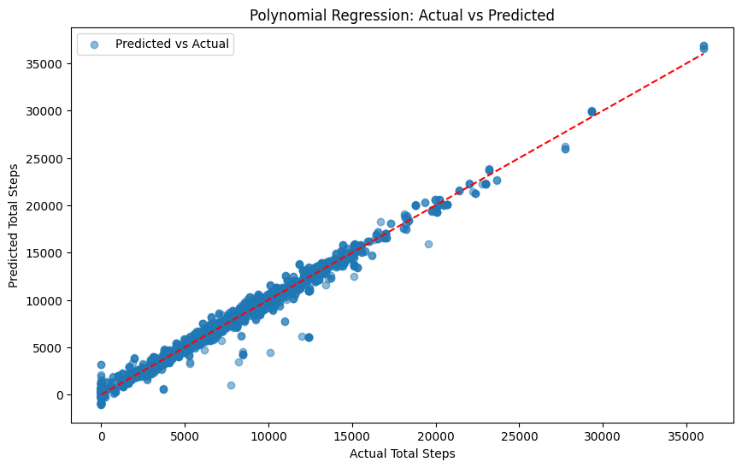
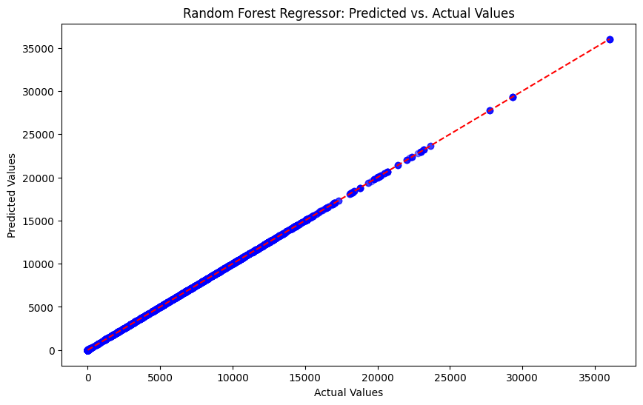
MODEL EVALUATION
Fig: Polynomial Regression
Fig: Random Forest Regressor

Slide 10
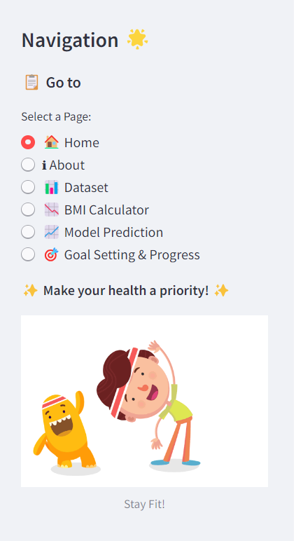
STREAMLIT APP DEVELOPMENT
The Fitness Tracker app was developed to predict daily steps based on user input using a Random Forest model, incorporating features such as BMI calculation and goal tracking.
The machine learning model was trained and saved which was then integrated into a Streamlit application.
The app provides an interactive interface for users to input their weight and height, view predictions, and track their fitness goals.
The project combines machine learning with user-friendly web application features, enhancing fitness tracking through real-time predictions and visual feedback.

Slide 11
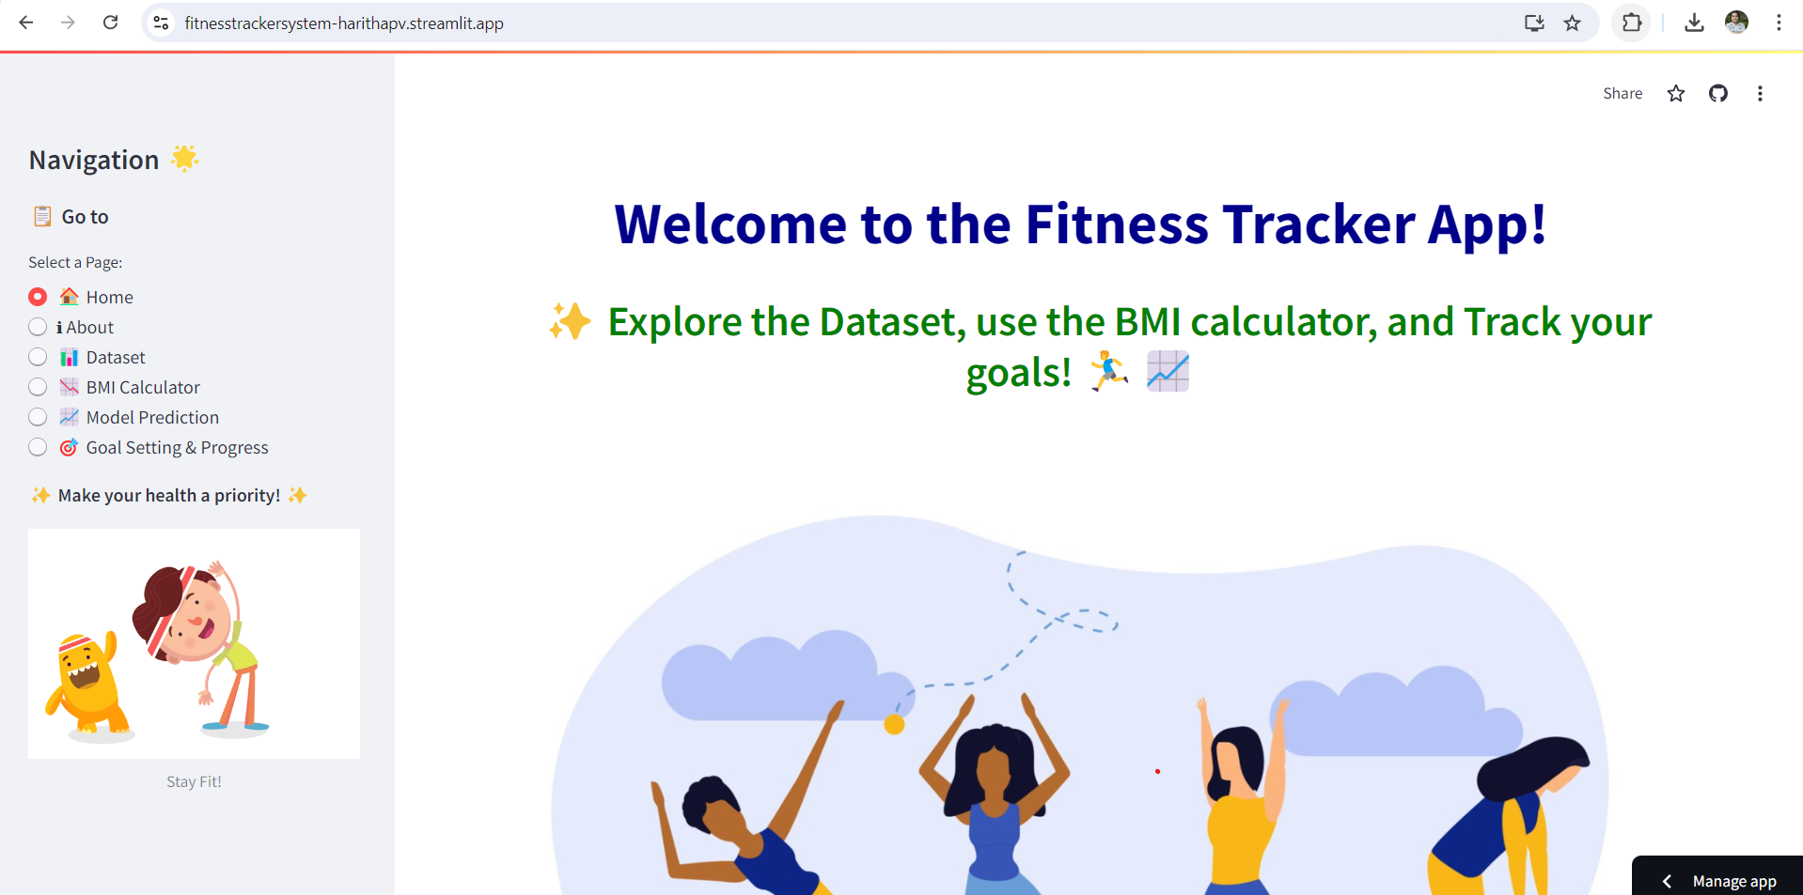
https://fitnesstrackersystem-harithapv.streamlit.app/
STREAMLIT APP

Slide 12
SUMMARY
The Fitness Tracker project combines the Random Forest model and a Streamlit app to predict daily steps based on weight and height.
The app offers features for BMI calculation, goal tracking, and dataset exploration, providing an interactive and user-friendly experience.
Streamlit enables real-time predictions and dynamic user engagement, demonstrating the effective use of machine learning in fitness applications.

Slide 13

FUTURE SCOPE
Enhanced Model Accuracy: Explore advanced machine learning models and techniques to improve prediction accuracy and robustness for various fitness metrics.
Additional Features: Integrate more fitness-related features such as heart rate monitoring, calorie tracking, and workout suggestions for a comprehensive fitness experience.
User Personalization: Develop algorithms for personalized recommendations based on individual fitness goals, activity history, and health data.
Cross-Platform Integration: Expand the app’s functionality to integrate with wearable devices and health platforms, providing seamless data synchronization and enriched user experience.

Slide 14
THANKYOU

